Slide 1



SMART INDIA HACKATHON 2026
TITLE PAGE
  Problem Statement ID – 26108
  Problem Statement Title- AI-Powered Recommendation Engine for Identifying Applicable Indian Standards for Procurement Specifications
  Theme- Smart Automation
  PS Category- Software
  Team ID-
  Team Name- ByteMinds

Slide 2
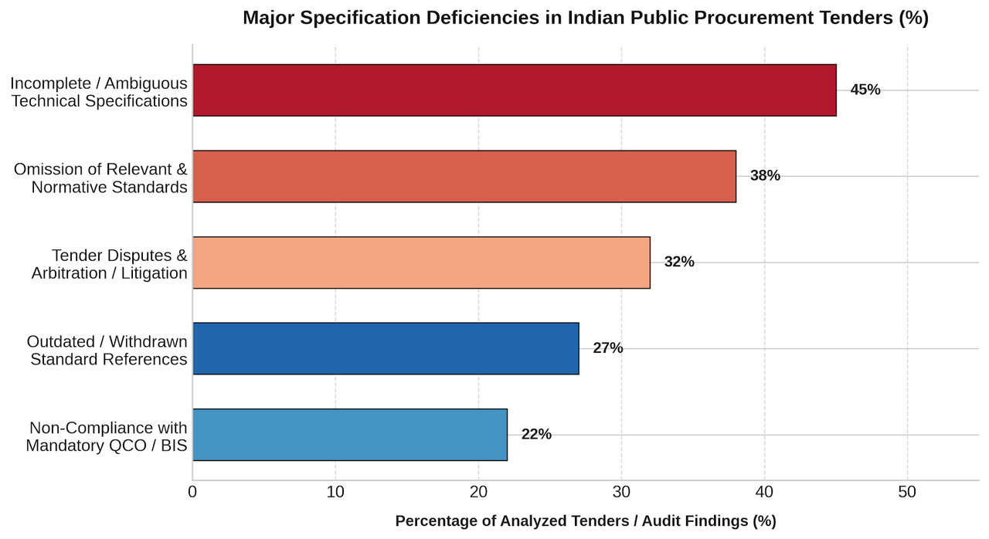
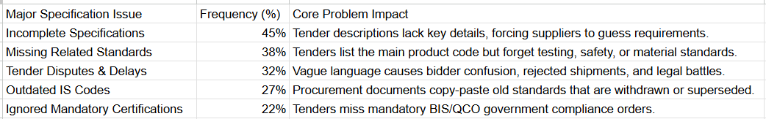
IDEA TITLE
ByteMinds
❖ Proposed Solution:
  AI understands tender requirements and product specifications.
  Semantic search finds the most relevant Indian Standards.
  Connects related standards — allied, test, safety & installation.
  Checks latest versions and identifies outdated/withdrawn standards.
  Verifies compliance with applicable BIS / QCO / CRS requirements.
  Generates a complete recommendation with the primary IS and related standards.
@SIH Idea submission- Template
2

Slide 3
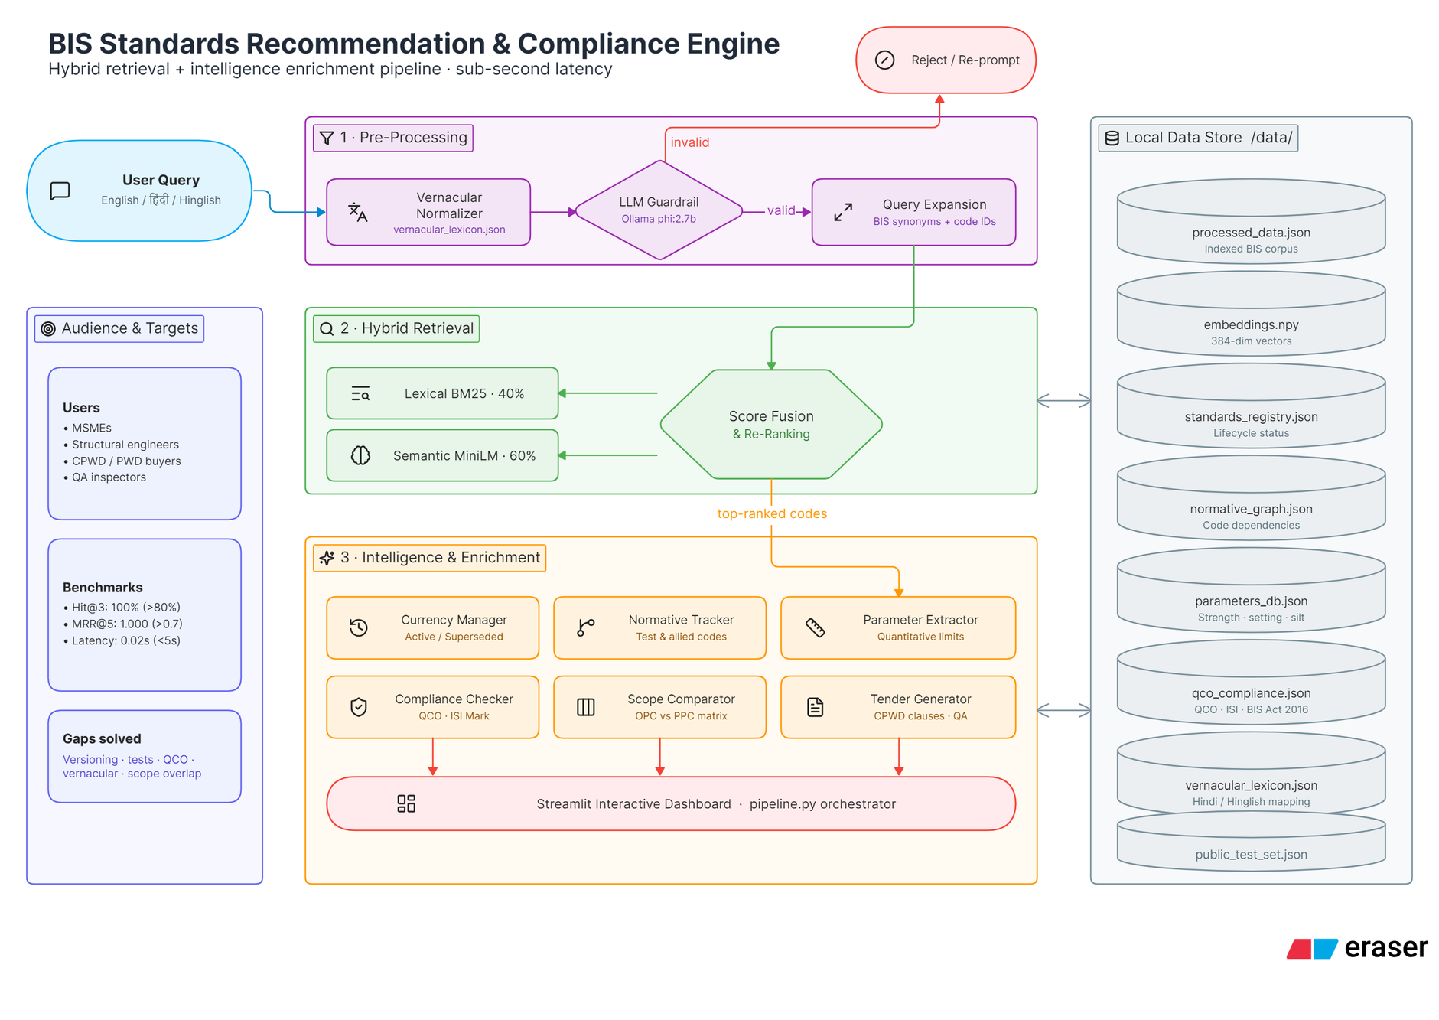
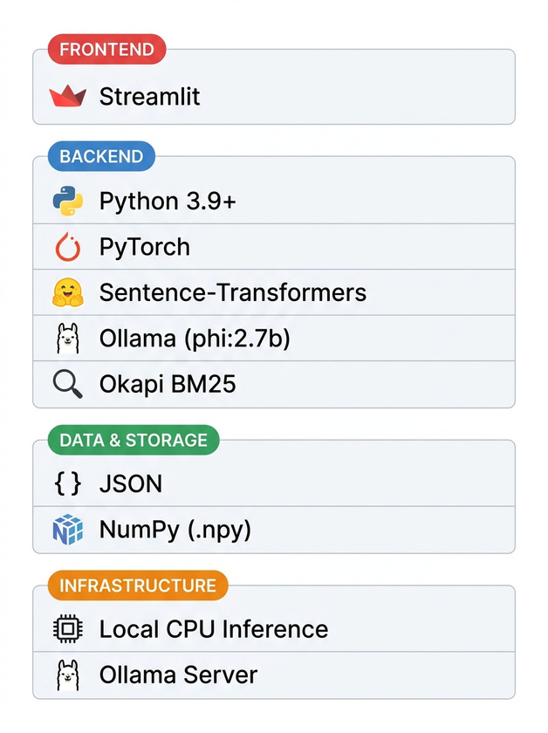
TECHNICAL APPROACH
ByteMinds
❖ Tech stack
@SIH Idea submission- Template
3

Slide 4
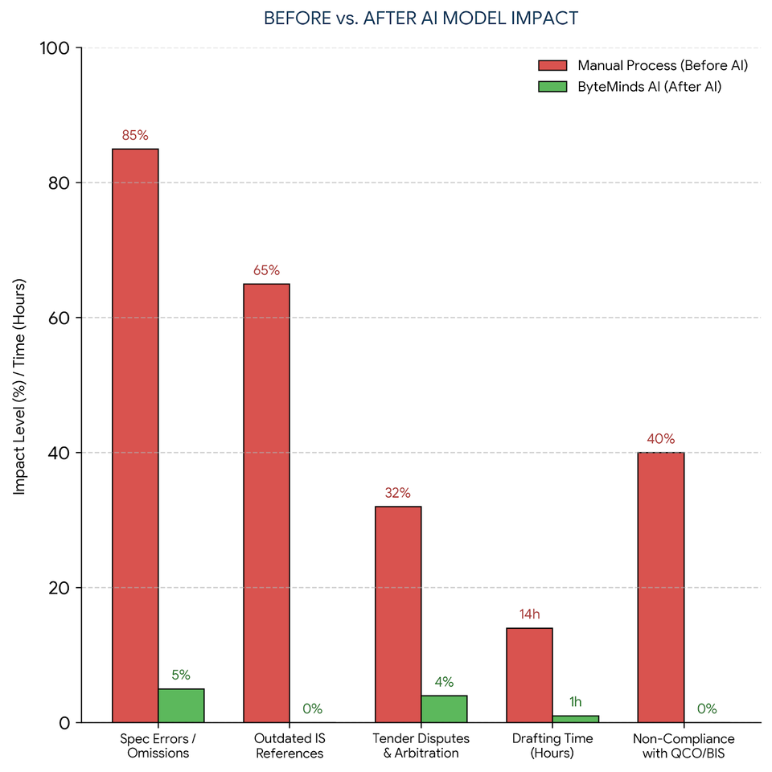
FEASIBILITY AND VIABILITY
ByteMinds
Feasibility
  Data Access: Built using public BIS catalogs, QCOs, and tender archives.
  Smart Tech: Uses Hybrid Graph-RAG (Neo4j + Vector DB) to accurately link standards without errors.
  Easy Integration: Hooks directly into portals like GeM via browser extensions or APIs with zero user training needed.
  Multilingual: Supports queries in multiple regional Indian languages for non-technical users.
Viability
  Low Cost: Built on open-source tools (Python, Neo4j, Hugging Face) to keep operational expenses low.
  Big Savings: Prevents expensive tender rewrites, legal disputes, and rejected shipments.
  Easy Scaling: Uses standardized APIs to scale across local, state, and central portals effortlessly.
  Auto-Updates: Web scrapers automatically pull the latest BIS revisions and QCO updates in real time.
@SIH Idea submission- Template
4

Slide 5

IMPACT AND BENEFITS
ByteMinds
Safety, Quality & Standards
  Enforces latest BIS codes to prevent structural failures across public works.
  Graph engine ensures critical tests (compressive strength, silt content) are included.
  Standardizes specs across major agencies (CPWD, PWD, NHAI).
  Auto-detects withdrawn/outdated codes and routes to current active versions.
  Delivers complete data: specs, test limits, allied codes, and compliance rules.
Procurement, Legal & MSME Protection
  Identifies mandatory ISI marks and QCO rules to shield MSMEs from fines.
  Standardizes tender clauses to eliminate contract ambiguity and corruption.
  Enables small contractors to independently verify compliance without consultants.
  Generates ready-to-use CPWD/PWD contract text directly.
  Verifies regulatory obligations prior to bidding or manufacturing.
Speed, Tech Efficiency & Cost
  Delivers top 3 BIS search results in 0.02 seconds.
  Converts hours of manual document search into instant technical retrieval.
  Runs 100% locally on standard hardware—zero cloud, GPU, or subscription costs.
  Applied LLM guardrails keep all outputs focused strictly on engineering domain.
  Generates actionable site inspection checklists (MTC, cement age, sampling).
Accessibility, Localization & Sustainability
  Breaks language barriers for Hindi-speaking contractors in Tier 2/3 cities.
  Understands natural regional queries (e.g., "सरिया Fe 500D", "chhat ki cement").
  Promotes sustainable materials (M-Sand, recycled aggregates, blended cements).
  Evaluates material trade-offs (OPC vs PPC vs PSC) for optimal durability.
  Unifies BIS requirements into one central system for contractors and engineers.
@SIH Idea submission- Template
5

Slide 6
RESEARCH AND REFERENCES
ByteMinds
niriksh
Domain & Regulatory Framework
  Standards Registry: Bureau of Indian Standards Official Portal BIS.gov.in
  Tender & QA Guidelines: Central Public Works Department (CPWD) General Specifications. CPWD Publications
  Legal Compliance: The Bureau of Indian Standards (BIS) Act, 2016 (Focus on Sections 16 & 29 for penalties). Read Official Gazette (PDF)
AI & Technical Research
  Semantic Embeddings (all-MiniLM-L6-v2): Reimers & Gurevych (2019), Sentence-BERT: Sentence Embeddings using Siamese BERT-Networks. View HuggingFace Model
Local LLM Guardrails (Phi-2): Microsoft Research (2023), Phi-2: The surprising power of small language models. Read Microsoft Research Blog
  Lexical Retrieval Engine: Okapi BM25 (Probabilistic Relevance Framework). Read Overview
6

